Slide 1

build your own stock Portfolio data visualization project
How to Trade Online: The definitive guide to online trading
Shreyashi Mukhopadhyay

Slide 2


case study Storyline
Jane Doe is a successful professional in her mid 30’s.
She is a disciplined investor and invests in various tax saving financial instruments from time to time.
She has a “very good” credit score rating.
She has a short-term as well as long-term investment outlook.
She just accepted a job offer that allows her flexible timings to work from home.
She usually invests in mutual funds but now she would like to invest the money to trade the equity market by herself.
She has also received her severance package from her previous employer and since she doesn’t want to park the funds in her bank account she is now considering various options of investing that money.

Slide 3


buyer’s dilemma

Slide 4
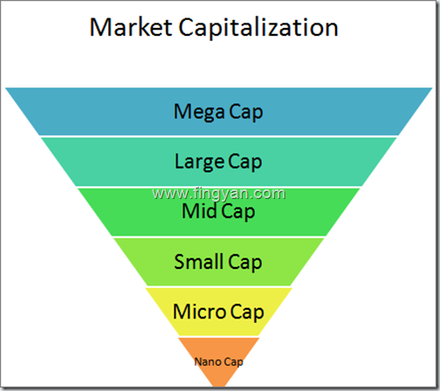
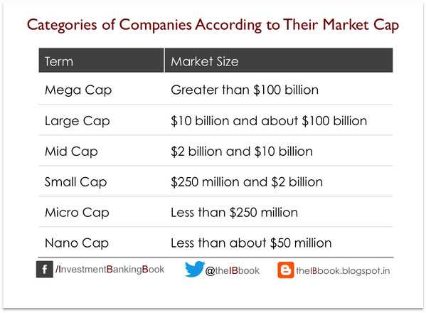
Market capitalization

Slide 5
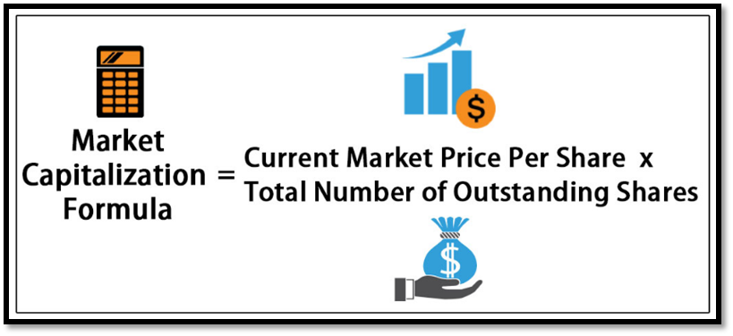
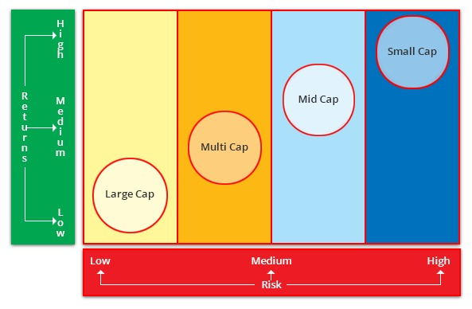
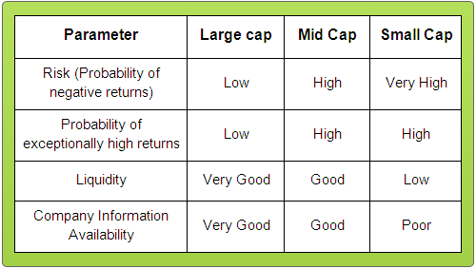
Market cap calculation and risk vs return

Slide 6
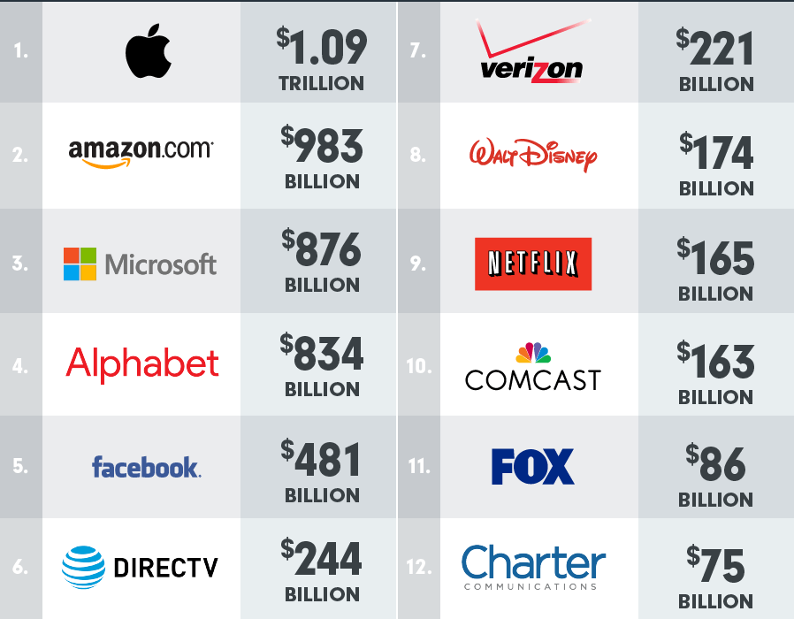
Market cap of top tech and communication companies

Slide 7
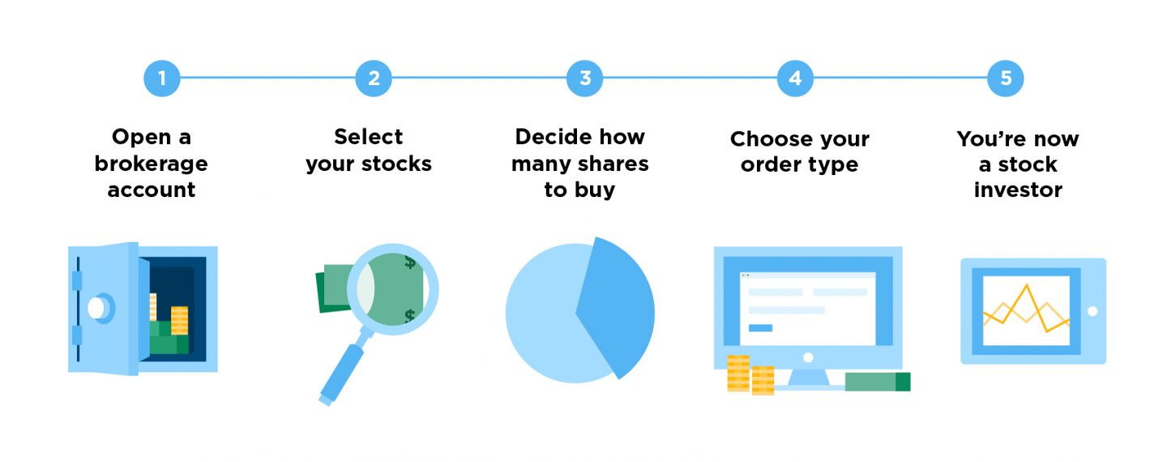
let’s start trading!
Best Online Brokers for Stock Trading
Online Broker | Best For | Minimum Deposit | Commissions | Overall Rating
TD Ameritrade | Best Overall | $0 | $0 | 4.5 Stars
Fidelity | Best for Investors | $0 | $0 | 4.5 Stars
Charles Schwab | Best for IRA Accounts | $1,000 | $0 | 4 Stars
E*TRADE | Best Web Platform | $0 | $0 | 4 Stars
Interactive Brokers | Best for Professionals | $10,000 | $.005 per share | 4 Stars
Merrill Edge | Best Rewards program | $0 | $0 | 4 Stars
TradeStation | Best Platform Technology | $0 | $0 | 3.5 Stars

Slide 8

primary trading parameter: Stock volume analysis
Less Volatility : Stocks that change hands rapidly have fewer dramatic price changes.
Less Reactive : High volume stocks will not move as quickly as small volume stocks on news events since there are more investors in the market for the stock at any one time.
Investor Benefits: The low volatility and reactivity of high-volume stocks can create a competitive environment for investors, leading to higher prices.
Issuer Benefits: The high trading volume indicates that there are many buyers competing for the asset, and the laws of supply and demand will cause price appreciation.

Slide 9

large Cap stocks
Here are some popular Large cap stocks favored by Analysts:
Rank Company Market Cap(billions) Industry Symbol
1 Microsoft $1058 Software MSFT
2 Apple $959 Tech AAPL
3 Amazon $959 Retail AMZN
4 Alphabet $839 Software GOOGL
5 Facebook $550 Software FB
6 Berkshire Hathaway $496 Diversified BRK-A
7 Tencent $436 Diversified TCEHY
8 Alibaba $431 Diversified BABA
9 Visa $389 Financial V
10 JPMorgan Chase $366 Financial JPM

Slide 10

mid Cap stocks
Here are some popular mid cap stocks favored by Analysts:
Symbol Company
RRD R.R. Donnelley & Sons
ANV Allied Nevada Gold
SOA Solutia
ENR Energizer
WYN Wyndham Worldwide
WMS WMS Industries
GDI Gardner Denver
WRC Warnaco Group
EMN Eastman
AMG Affiliated Managers

Slide 11

Small Cap stocks
Here are some popular mid cap stocks favored by Analysts:
1. Axos Financial (NYSE:AX)
2. Callaway Golf (NYSE:ELY)
3. Fastly (NYSE:FSLY)
4. Freshpet (NASDAQ:FRPT)
5. Inspire Medical (NYSE:INSP)
6. Instructure (NYSE:INST)
7. LivePerson (NASDAQ:LPSN)
8. OrganiGram (NASDAQ:OGI)
9. Redfin (NASDAQ:RDFN)
10. Rubicon Project (NYSE:RUBI)
SOURCE: FOOL.COM

Slide 12

MICRO Cap stocks
Here are some popular micro cap stocks favored by Analysts:
Company & Stock Ticker | Price | Return in the Past 12 Months
Stage Stores Inc (NYSE:SSI) | $7.50 | +1,139%
Cassava Sciences Inc (NASDAQ:SAVA) | $8.10 | +648%
Novume Solutions Inc (NASDAQ: REKR) | $3.84 | +593%
Hebron Technology Co Ltd (NASDAQ: HEBT) | $6.45 | +519%
Workhorse Group Inc (NASDAQ: WKHS) | $3.45 | +333%
Orion Energy Systems, Inc. (NASDAQ: OESX) | $3.47 | +328%
Microbot Medical Inc (NASDAQ: MBOT) | $13.06 | +316%
Bioanalytical Systems, Inc. (NASDAQ: BASI) | $5.19 | +293%
Repro-Med Systems, Inc. (NASDAQ: KRMD) | $5.54 | +292%
Agile Therapeutics Inc (NASDAQ: AGRX) | $2.96 | +261%
Source: Google Finance, last accessed January 10, 2020

Slide 13

Need to know
When to Buy
When to Sell
When to Hold

Slide 14
Portfolio Growth

Slide 15

Thank you
Data Source:
https://www.barchart.com
https://www.wallstreetsurvivor.com
https://www.fool.com
https://www.thebalance.com
https://finance.yahoo.com
https://www.profitconfidential.com
https://www.wallstreetmojo.com
https://www.investor.gov
Image Source:
https://www.shutterstock.com/
https://www.gettyimages.com/
Thank you!

